Slide 1
Club Management System
Group 2

Slide 2



Have you ever…

Slide 3
Our Application – NextGeneration
Using an intelligent system can lower the cost, reduce human errors, and also increase efficiency.
NextGeneration accepts, stores, and updates the information of teachers.
The ultimate goal is to provide an efficient way to access and manage all the clubs' records.

Slide 4
Main Function
Record and list out new teacher
Keep track of each teacher assigned annual leave quota and personal information.
Make sure no repeated staff record.
Register and show new Team
Each teacher can manager one or more teams, even no teams.
Document Employee's Annual Leave
Employees are allowed to take leaves based on their requests, like No-pay Leave, Annual Leave, Compensation Leave.

Slide 5
PROJECT PLANNING

Slide 6
Project Team Organization
Member | Role
WANG Ka Chun | Programmer, Project Manager
WONG Siu Fai | Programmer, Configuration Manager
HO Kwan To | Programmer, Testing Engineer

Slide 7
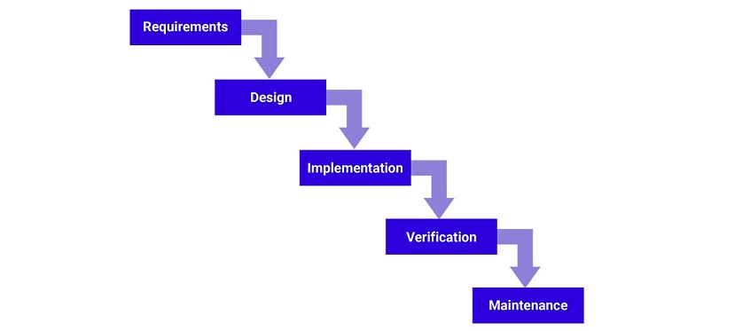
Software Development Methodology
We use the Waterfall development method.
Reason: our team has clear objectives and stable requirements.
Pros:
easy to understand and
manage
A schedule can be set
with deadlines for each
stage of development.

Slide 8
Work breakdown Structure
Requirements Gathering
Topic Discussion
Research
Design & Analysis
Algorithm Design
Database Design
Software Development
Algorithm Implementation
Database Implementation
Testing & Development
Unit Test
System Test
Integration Test
User Acceptance Test

Slide 9
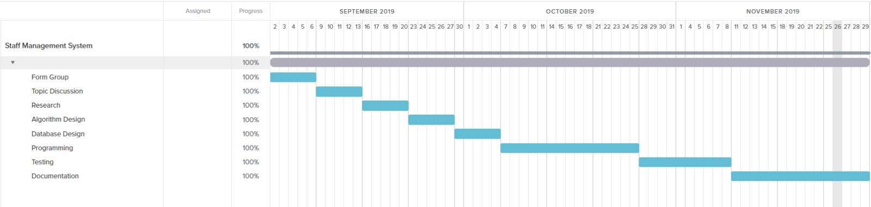
Project Schedule

Slide 10
Resource Assign
Problem
Limited human resources and time.
Solution:
Each teammate responsible for multiple roles.
Light code, and simplicity is the central aspect of our whole development process.
Continue to play “what if…” to better optimize

Slide 11
The Software

Slide 12
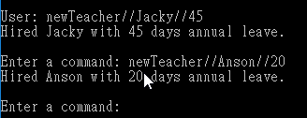
Program process
Adding new teachers: “newTeacher//TEACHER_NAME//LEAVE_QUOTA”

Slide 13
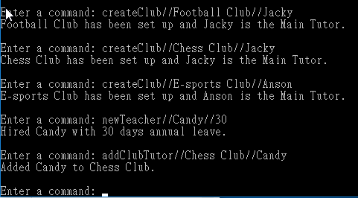
Program process
Creating new Extra-curriculum activities(Club): “createClub//CLUB_NAME//NAME_OF_MAIN_TUTOR”
Adding teacher to a club: “addClubTutor//CLUB_NAME//TEACHER_NAME”

Slide 14
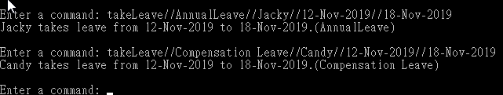
Program process
Mark down the leave taken by the teacher:
“takeLeave//LEAVE_TYPE// TEACHER_NAME //START_DATE//END_DATE”

Slide 15
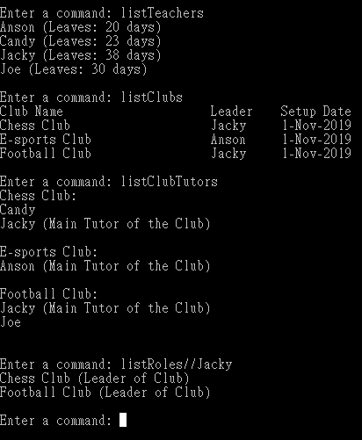
Program process
Display all information in term of Teacher, Club or Leave Record:
"listTeachers": view all teachers and
corresponding remaining leave quota.
"listClubs": view all clubs and their
main tutor and start date.
“addClubTutor”: view main tutor at
each club.
“listRoles//TEACHER_NAME”:
view teacher’s role in all clubs.

Slide 16
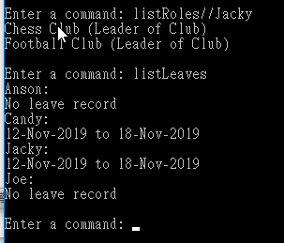
Program process
“listLeaves”: view teacher’s leave record.

Slide 17
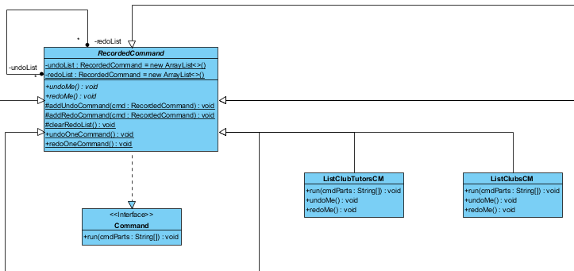
Design Pattern – Command Pattern
Clients can have different requests easily
Clients can save commands in the to test out the effect

Slide 18
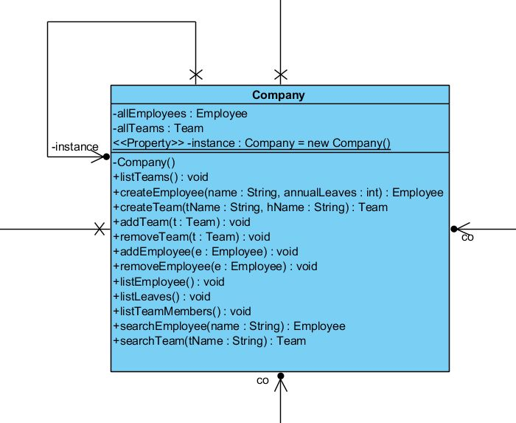
Design Pattern-
Singleton Pattern
Give a global access point
Limit Object instance on one only ever

Slide 19
Design Principle – Open-Closed Principle
New commands can be easily added/extended
But entities like teachers are protected and cannot be modified

Slide 20
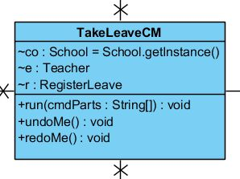
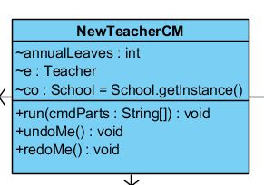
Design Principle-
Single Responsibility Principle
All the CM classes only have one purpose per class and can only do one thing

Slide 21
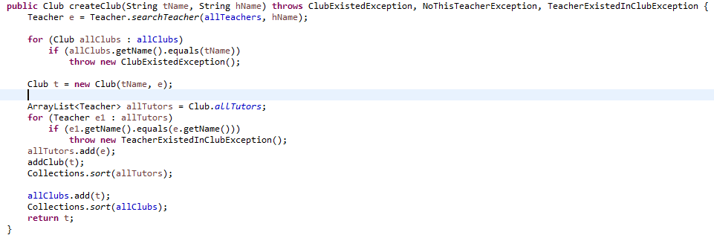
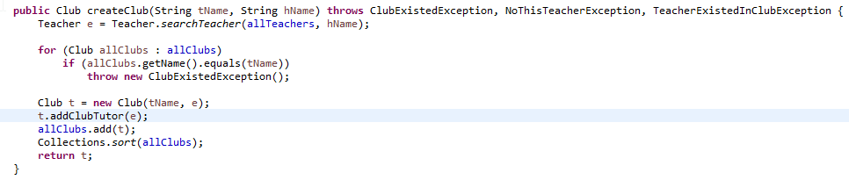
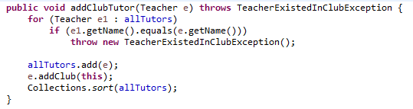
Code Refactoring

Slide 22
Testing

Slide 23
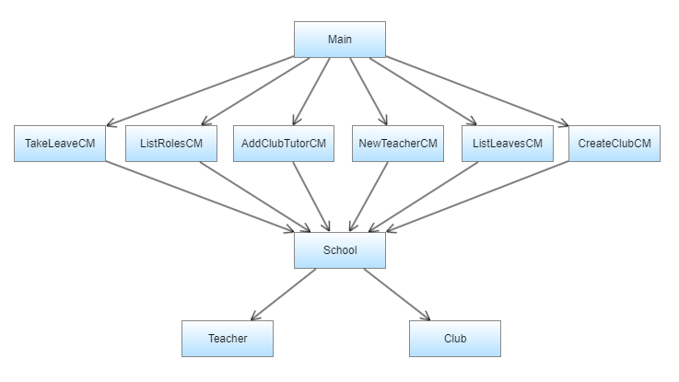
Hierarchy Diagram

Slide 24
Top-Down Approach
Test the functions from high to low levels
Unit Testing: Main
Integration Testing 1:
Main + Command (AddClubTutorCM, CreateClubCM,etc,)
Integration Testing 2:
Main + Command + School
System Testing: Main + Command + School + Teacher + Club

Slide 25

Unit Testing

Slide 26
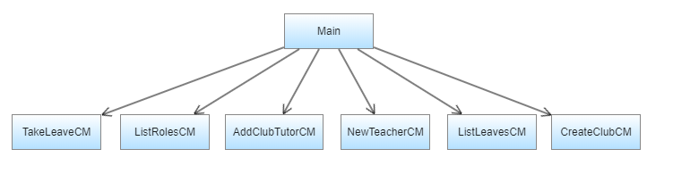
Integration Testing 1

Slide 27
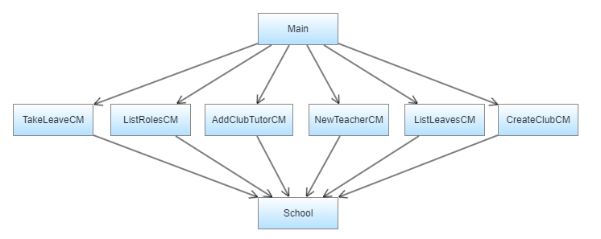
Integration Testing 2

Slide 28
System Testing

Slide 29
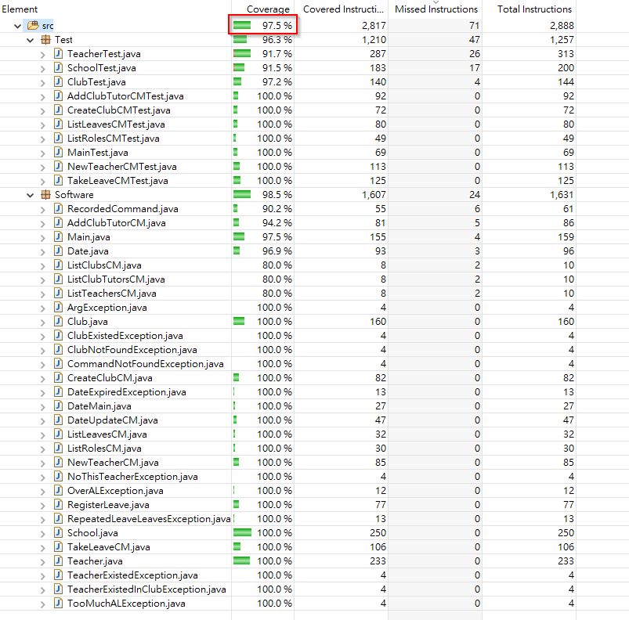
Test Coverage

Slide 30
Configuration

Slide 31
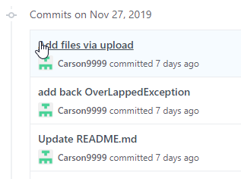

Configuration
We use Github and Google Drive for Source Control Tool
Github – To maintain the consistency of the code
Google Drive – To keep track of amendment of different Documents.

Slide 32
Configuration
We use following software for Development tools and testing tools
Eclipse
JUnit 5
EclEmma

